Slide 1
Variational Autoencoders

Slide 2
INSTRUCTIONS FOR MLE
What to cover here
1. Lead us through example of single Gaussian MLE for the mean and variance p( X | \mu, \sigma ), where X is the data.
2. Walk us through the EM approach of estimating \mu_i, \sigma_i \forall i in a 1D GMM.
3. Bring (2) back home to MLE showing that the result is point estimates for the parameters of interest and we have just averaged over z to get them
time-limit
Make this around 10 minutes, not more
Think of this as a minute per slide, thus 10 slides total
You are free to use any and all literature on the topic
Textbooks are fine. Bishop is particularly good, but you can use anything you like better. If in doubt please ask on slack in the #papers channel

Slide 3
Presenter: Rogers F. Silva
Point Estimates:
Maximum Likelihood and Expectation Maximization
We want THE best, we want THE optimal!

Slide 4
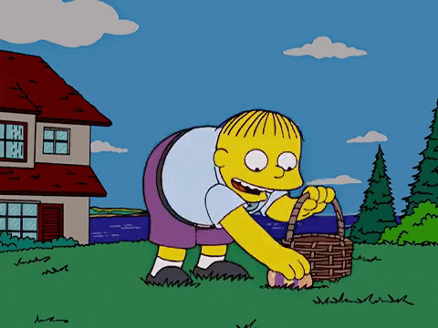
HUNT FOR 𝛉
Find the parameter values of
the distribution that generated your data

Slide 5
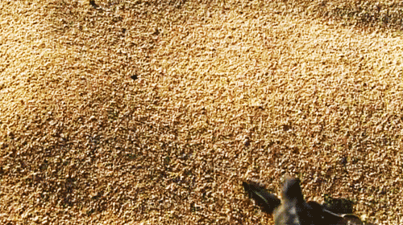
Maximum Likelihood Estimation (MLE)
Steps:
Pick distribution: p(x|𝛉)
Form data likelihood: i.i.d.
p(D|𝛉) = Π_{i}p(x_{i}|𝛉)
Maximize:
0 = Gradient wrt 𝛉, solve for 𝛉

Slide 6
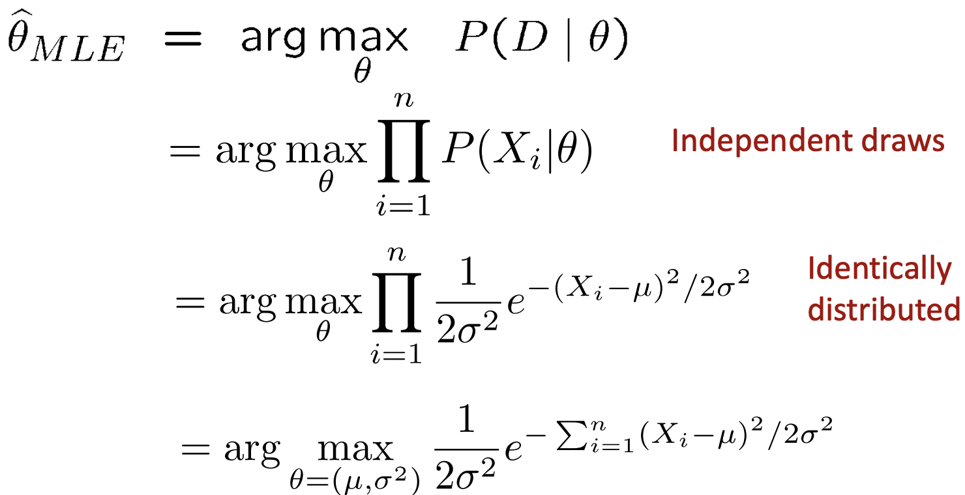
MLE of 1D Gaussian

Slide 7
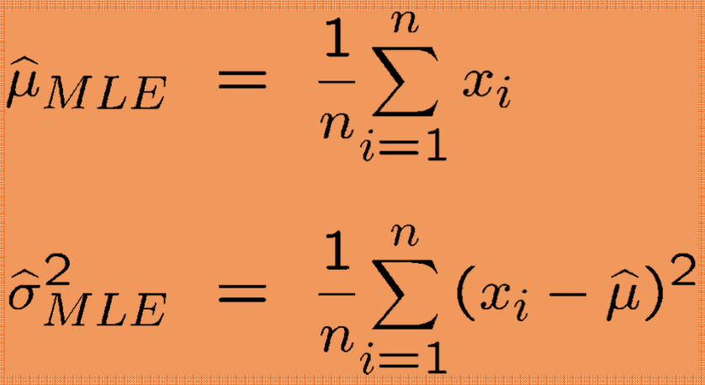
MLE of 1D Gaussian

Slide 8
MIXTURE MODELS
Proceed with caution.

Slide 9
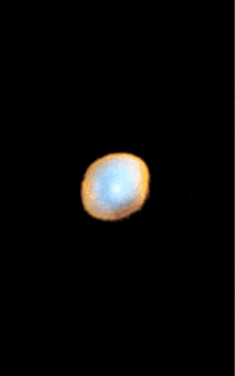
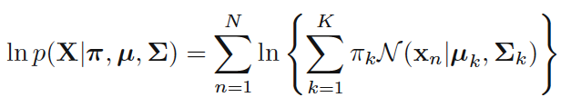
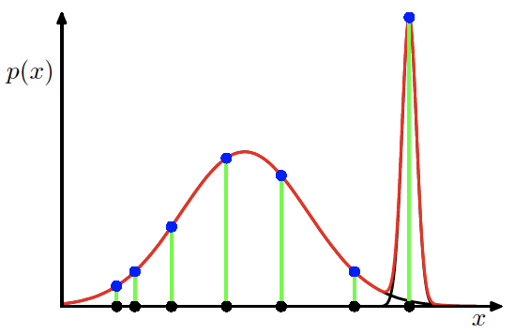
MLE of 1D Gaussian Mixture
Likelihood
Singularities

Slide 10
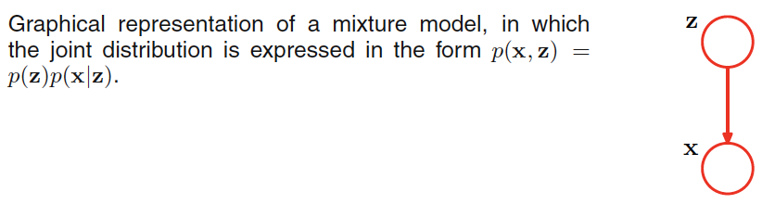
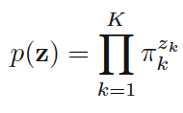
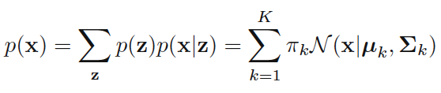
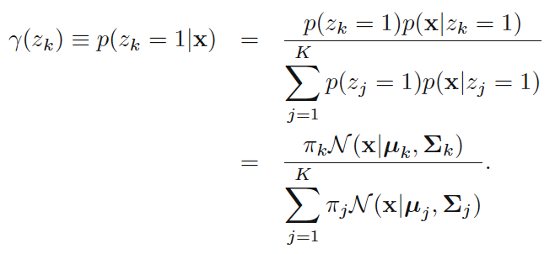
Adding a Latent Variable z
Indicator variable:

Slide 11
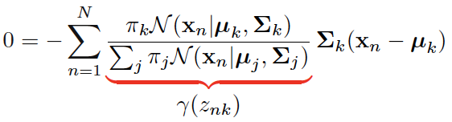
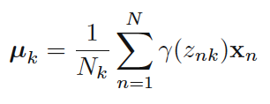
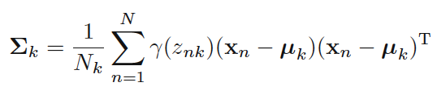
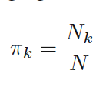
Expectation Maximization (EM) for GM

Slide 12
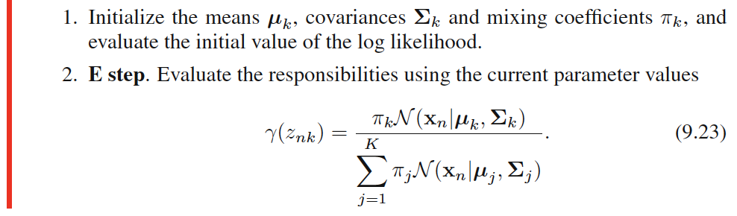
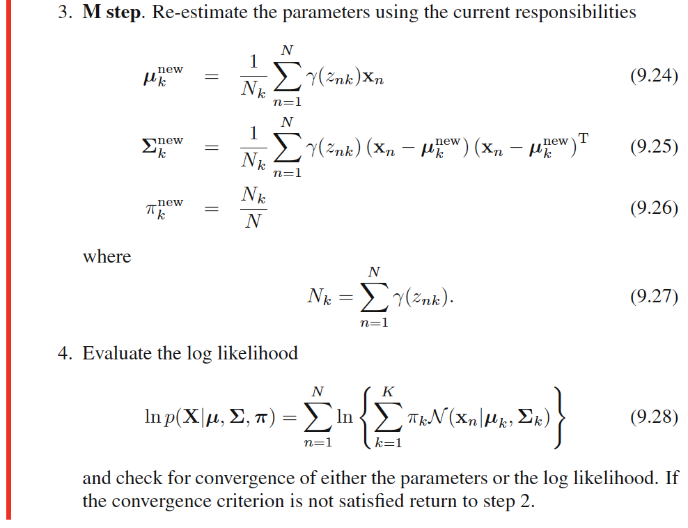
Expectation Maximization (EM) for GM
Expectation of
indicator variable z
under the posterior distribution
p(z|x), for each sample n
Provably, EM always increases
the likelihood.
Christopher M. Bishop
Pattern Recognition and
Machine Learning, 2006

Slide 13

Summary
Both MLE and EM yield point estimates.
Both optimize the same likelihood.
EM does it in a different way, which relates nicely with Bayesian and variational methods.

Slide 14

Presenter: Brad
Bayesian Inference
We still want THE best, we still want THE optimal! But we are Bayesian and we are better!

Slide 15
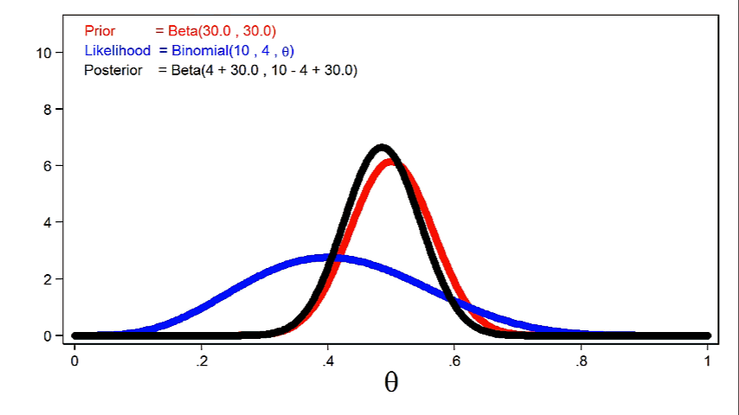
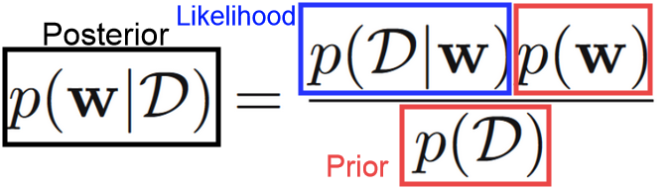
From Points to Priors

Slide 16
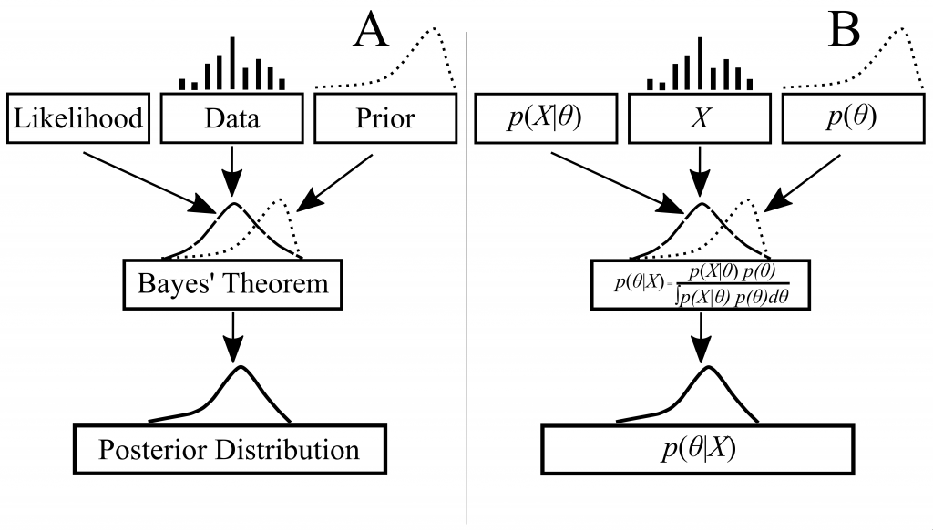
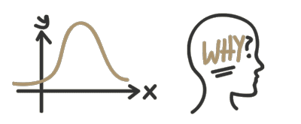
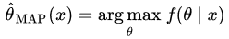
Doing Inference

Slide 17
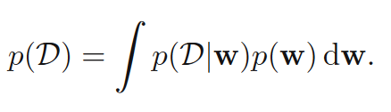
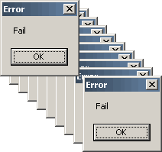

Problem: Intractability of Marginal Likelihood
No analytic solution for many interesting cases!
Example: Bayesian Mixture Models for T2 Segmentation (Schmidt et al. 2013)
Many other high-dimensional problems

Slide 18
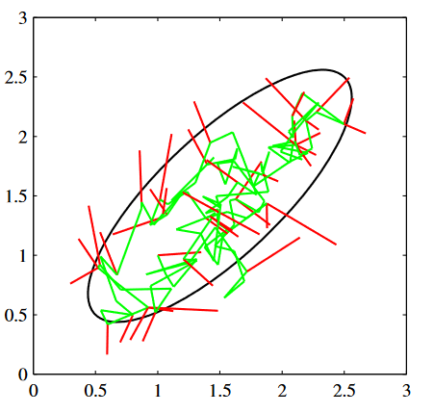

Solution: Approximate Bayesian Inference
Rejection Sampling
Importance Sampling
Markov Chain Monte Carlo
Metropolis Hastings​
Gibbs Sampling​
Slice Sampling​
Hybrid Monte-Carlo Algorithm

Slide 19

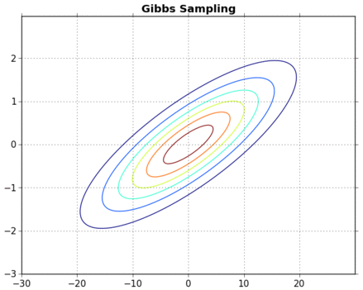
Gibbs Sampling
Idea: Sample Variables in sequence Use other variables to condition “Walk” to get an idea of the distribution
x₁⁽¹⁾ ~ p(x₁⁽⁰⁾|x₂ ⁽⁰⁾)
x₂⁽¹⁾ ~ p(x₂⁽⁰⁾|x₁ ⁽¹⁾)
x₁⁽²⁾ ~ p(x₁⁽¹⁾|x₂ ⁽¹⁾)
x₂⁽²⁾ ~ p(x₂⁽¹⁾|x₁ ⁽²⁾)
...

Slide 20
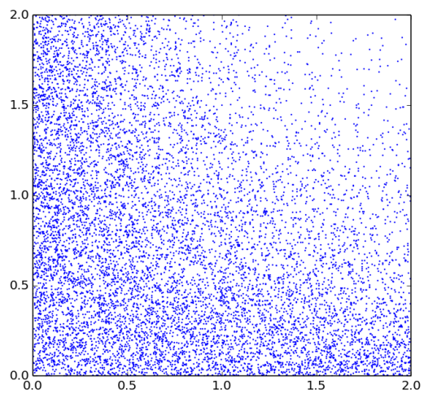
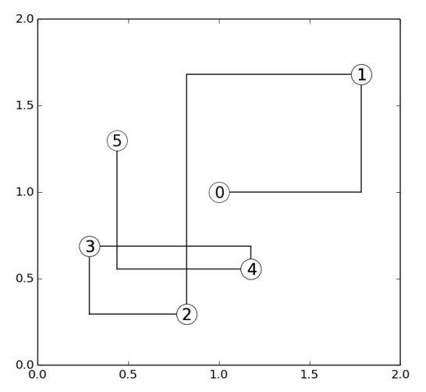
Gibbs Sampling (2-D example)
Suppose we have a bivariate distribution, with p.d.f p(x, y) ∝ e^{−xy}1(x, y ∈ (0, c)), c > 0
Since p(x,y) is symmetric, we just derive p(x|y) p(x|y) ∝_{x} p(x, y) ∝_{x} e^{−xy1}(0 < x < c) ∝_{x} Exp(x|y)1(x < c)
We can draw samples from this by Sampling U ~ Uniform(0,1 − e^{−yc}) Set p(x|y) = - (1/y)log(1-u), i.e the inverse CDF
Start with c=2, (x⁽⁰⁾,y⁽⁰⁾) = (1,1).
With u = 0.82 < 1-e⁻² we get p(x⁽¹⁾|y⁽⁰⁾) = -(1/1)ln(0.1) = 1.71480
… we could go on https://jwmi.github.io/BMS/chapter6-gibbs-sampling.pdf

Slide 21
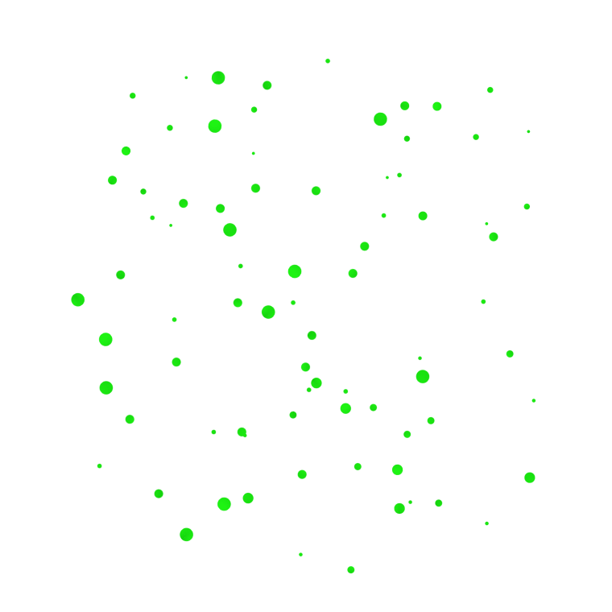

Limitations of Sampling
Can requires huge amount of samples
Require some derived of the conditional probabilities
Drawing the conditional probabilities can be expensive

Slide 22
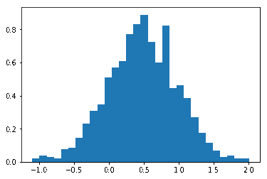

What do we end up with?

Slide 23
Calculus of Variations
as invented by:
Sir Issac Newton
Johann Bernoulli
Leonhard Euler
Joseph-Louis Lagrange
A collection of clever blokes

Slide 24
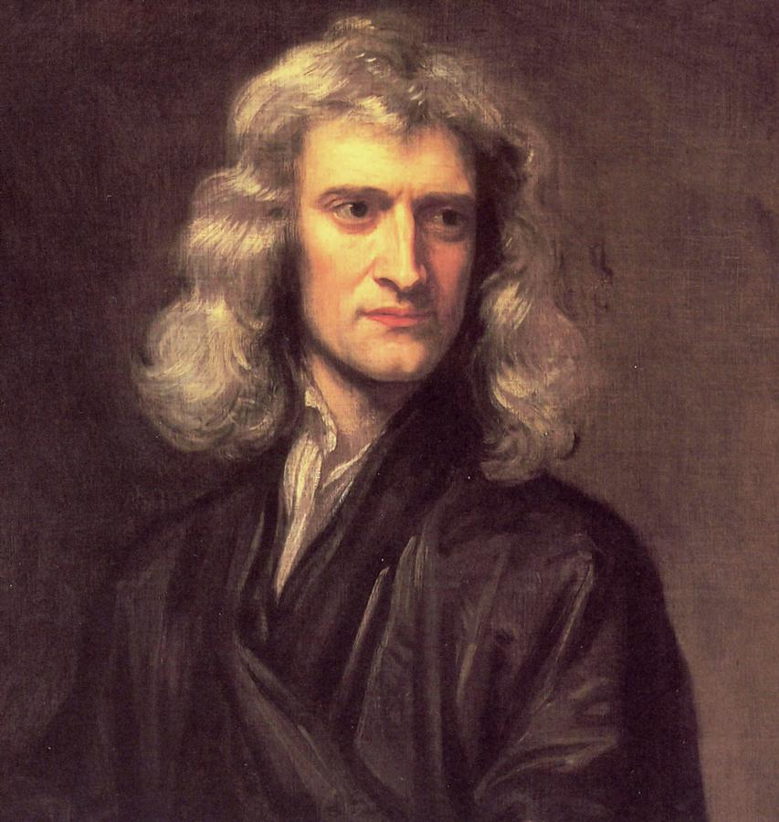
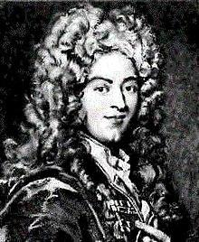
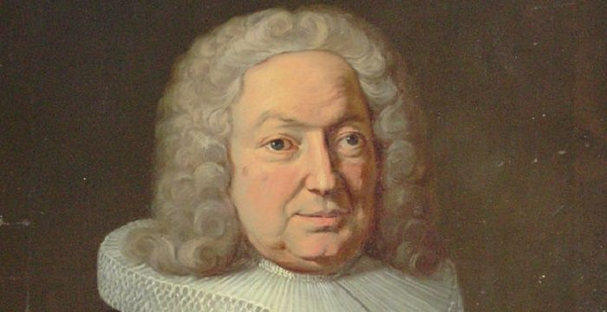
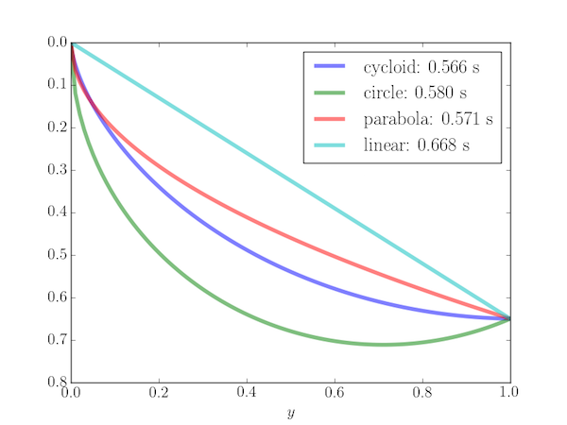
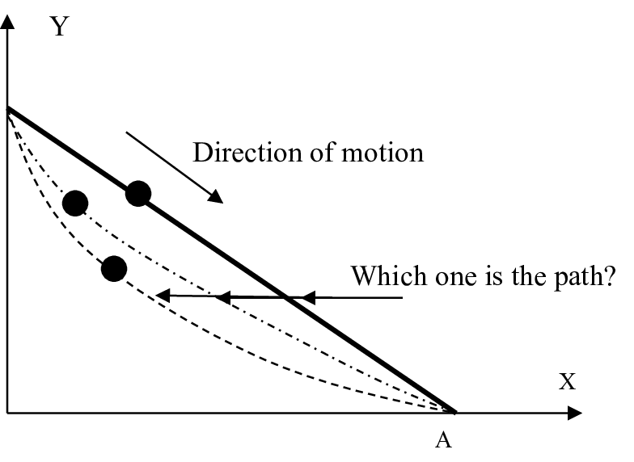
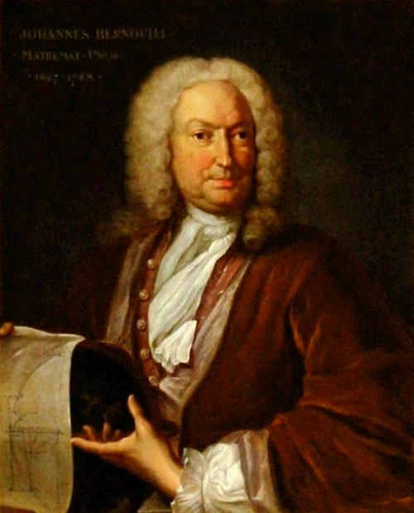
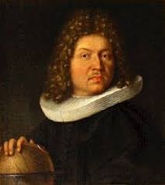
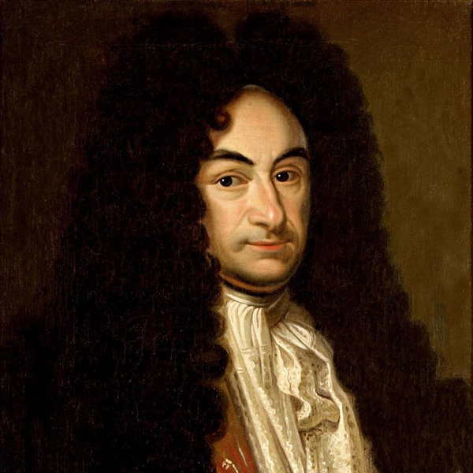
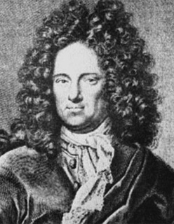
Deriving Max/minima before it was cool
SCHEISSE
Blatant
Horn
Tooting
Newton
de l’Hôpital
Jakob
Bernoulli
Johann Bernoulli
1696
Leibniz
Von Tschirnaus

Slide 25
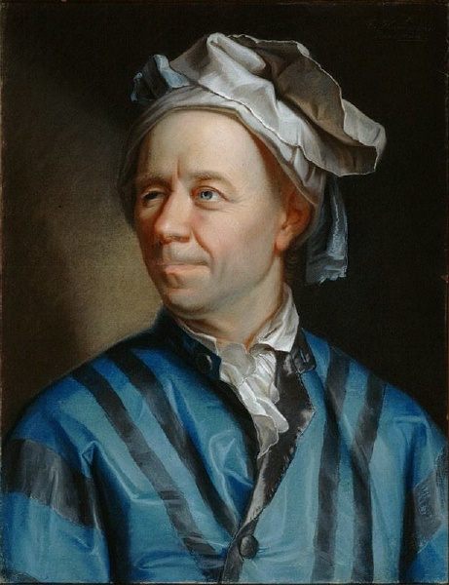
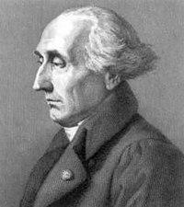
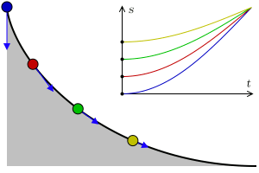
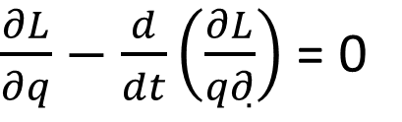
Deriving Max/minima before it was cool
SCHEISSE
Blatant
Horn
Tooting
Newton
de l’Hôpital
Jakob
Bernoulli
Johann Bernoulli
1696
Leibniz
Von Tschirnaus
Leonhard Euler
1750
Joseph-Louis Lagrange
1754-1756

Slide 26
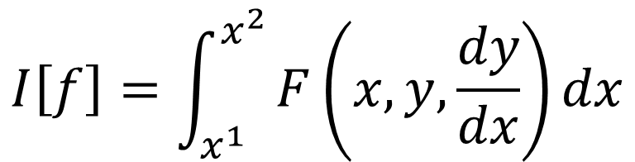
Calculus of Variations
Standard Calculus
Variational Calculus
find f’(x) or dy/dx = 0
Values which satisfy =0 are candidates for min/max.
These are stationary points, which don’t really tell you much about the nature of f(x) itself.
Here, we’re looking for stationary functions of functionals.
Your independent variable is a function, not a value.
Literally Anything

Slide 27
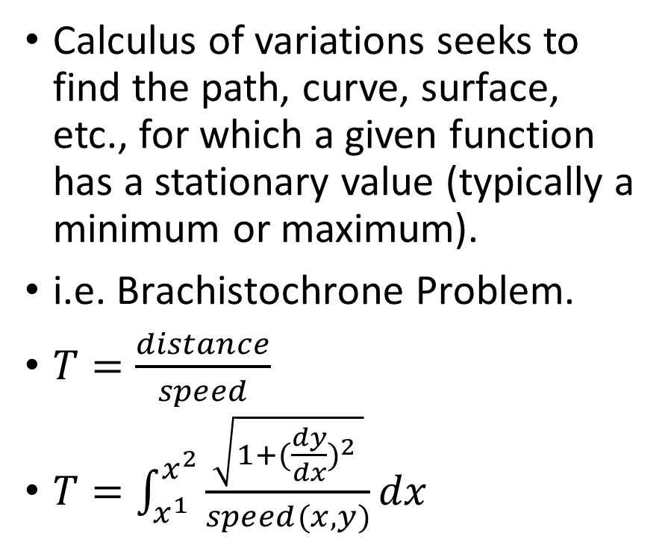
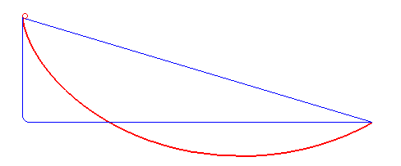
Calculus of Variations
gravity
Minimizes distance
Maximizes speed
Optimal
Solution

Slide 28
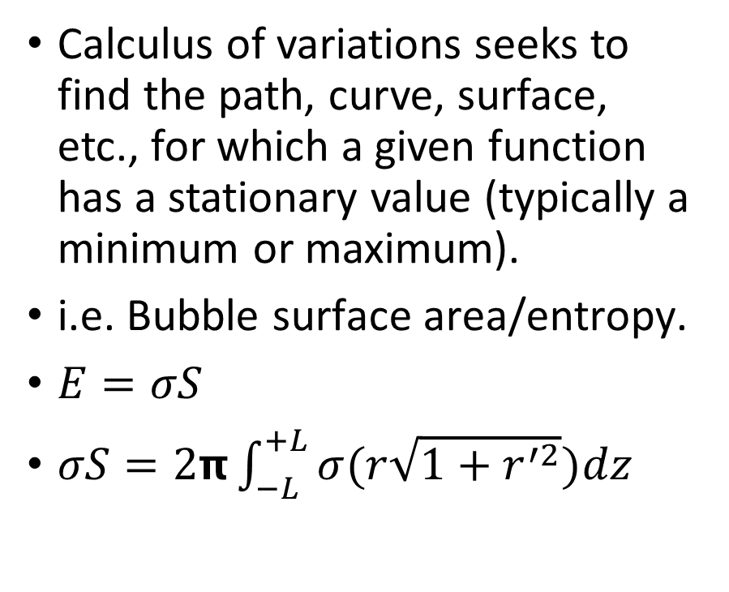
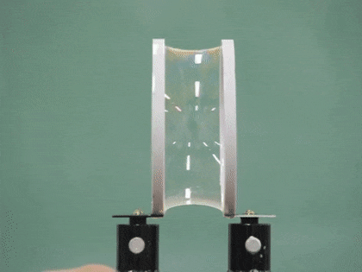
Calculus of Variations
z
+L
R
r(z)
-L
R

Slide 29
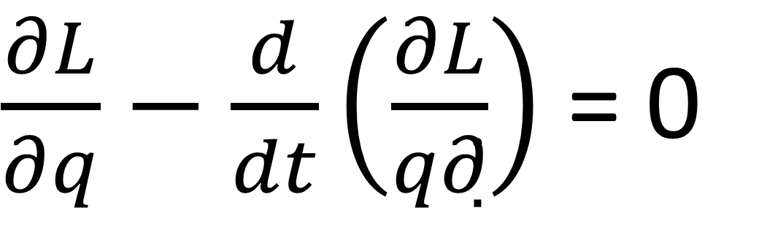
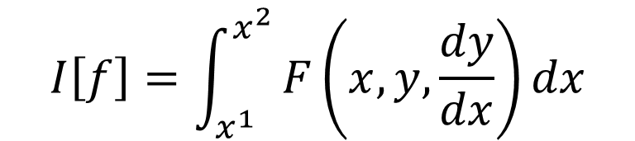
Calculus of Variations
Working with Extrema: Euler-Lagrange
We need boundary conditions:
y(x₁)=y₁ & y(x₂)=y₂
“Extrema”
Must be stationary
If y(x) is an extremal of I[f], then y(x) must satisfy this differential equation.

Slide 30
Presenter: Noah Lewis
Deep Latent Variable Models
Probabilistic Neural Networks

Slide 31

UNIVERSAL FUNCTION APPROXIMATION
Neural Networks can approximate most continuous functions
Not because of the choice of the activation function, but the feed-forward architecture itself
Approximation makes the intractable tractable

Slide 32


LATENT VARIABLES
Latent variables (z) are the unseen portion of the data
The marginal distribution (marginal likelihood) of the observed data can be defined as:
pΘ(x) is a mixture of distributions pΘ(x|z)

Slide 33

PROBABILISTIC GRAPHICAL MODELS
Joint distribution of all variables organized as a directed acyclic graph
Product of the prior and conditional probability between a node and its parents (Pa)
These conditional probabilities can be parameterized with a neural network

Slide 34


GRAPHICAL MODELS CONTINUED
Both neural networks and PGMs can be seen as graphical models

Slide 35

DEEP LATENT VARIABLE MODEL
DLVMs are neural networks that model the joint distribution between the observed and unobserved data [pΘ(x,z)]
The distributions are parameterized with a neural network
Example (factorization of the joint probability):
Factorization modeled with either pΘ(z) or pΘ(x|z)

Slide 36
Presenter: Harsh Gazula
Evidence Lower Bound & VAE
Autoencoder as DLVMs; Posterior as the optimal function; Objective function to optimize

Slide 37
INSTRUCTIONS FOR ELBO
What to cover here
1. tell us how an Auto encoder could be represented probabilistically, e.i. If drawn backwards output to input p(x|z)<-p(z)<-p(z|x)
2. Tell us how hard to model p(z|x) and that we instead use a neral network model q(z|x) parameters of which we optimize to optimize our objective
3. Show the objective log p(X), and arrive at ELBO = log p(X) - DKL(q(z|x)|p(z|x)). Show how maximizing ELBO we maximize the objective and “fit” q(z|x) to p(z|x) for free
4. Tell us that (3) is the intuition but can arrive at the symbolic form starting with DKL as well
5. Show how ELBO consists only of q(z|x) and p(x.z)
6. Reparameterization trick to optimize both
7. Go in detail over algorithm 2 here: https://arxiv.org/pdf/1906.02691.pdf
time-limit
Make this around 15 minutes, not more
Think of this as a minute per slide, thus 15 slides total
You are free to use any and all literature on the topic

Slide 38
Quick recap
So far, we have covered
MLE (point estimates of parameters)
EM Algorithm (point estimates of latents and parameters)
Bayesian Inference (approximating posterior via samples)
Variational Calculus
DLVM
Now……
Questions/Comments before we dive into the deep end of the ocean (well..not really)
where are we headed with all this...

Slide 39
Variational Bayesian Methods
Two pronged benefits
Statistical Inference: Provide an analytical approximation to the posterior probability of the unobserved variables. [P(Z|X)]
Model Selection: The idea being that a higher marginal likelihood for a given model indicates a better fit of the data by that model. [P(X)]. Typically done using ELBO.
I’ll go over both the approaches in this presentation.

Slide 40
Let’s start with the first goal
The goal is to infer good values of the latent variables given observed data or, in other words, to calculate the posterior P(Z|X)
However, P(Z|X) is difficult to estimate. Why? (Remember P(X))
So, we approximate P(Z|X) using Q(Z|X).

Slide 41


Posterior (Inference)

Slide 42


Let’s continue with the derivation

Slide 43

Now, the second goal
Now that we have a lot of data (evidence?), we want to fit a distribution to that data. P(X)???
Data Likelihood:
Posterior density also intractable:
Solution: In addition to modeling p_{θ}(x|z), we define an additional q_{ɸ}(z|x) that approximates p_{θ}(z|x)
Will see that this allows us to derive a lower bound on the data likelihood that is tractable, which we can optimize

Slide 44

Now, the second goal

Slide 45




Model Selection (continued)

Slide 46



Intuition behind ELBO
Make approximate posterior distribution close to prior
Reconstruct the input data
Variational lower bound (“ELBO”)
Training: Maximize lower bound

Slide 47
Connection to Auto-Encoder/Deep Latent Variable Models
Where’s the Generative part?
Where’s the Recognition/Inference part?
Where is Neural Network? What role is it playing here in VAE?

Slide 48

Variational Autoencoders

Slide 49

Okay..let’s visualize optimization (aka backprop)..
What??
uh-oh

Slide 50

Reparameterization Trick (ref)

Slide 51

After Reparameterization
neat

Slide 52

Optimization Scheme (do we need this) ehh..maybe

Slide 53
Final recap (takeaways...)
Where is MLE? (You saw it...P(X))
Where is Bayesian Inference (come on now) ?
Where is DLV? (Z???)
Where is Variational? (q(z|x) ??)
Hope no more head scratching about VAE…
Demo??

Slide 54
ANY QUESTIONS?
VAE is optimized. Now what?
Open discussion on how to use and work with VAEs
Let’s keep discussing the ideas and looking for ways to learn them deeper by applying them in unexpected ways

Slide 55
Thanks!
ANY QUESTIONS?
Let’s keep discussing the ideas and looking for ways to learn them deeper by applying them in unexpected ways

Slide 56
TRANSITION HEADLINE
1
Let’s start with the first set of slides

Slide 57
Quotations are commonly printed as a means of inspiration and to invoke philosophical thoughts from the reader.

Slide 58
THIS IS A SLIDE TITLE
Here you have:
A list of items
And some text
But remember not to overload your slides with content
Your audience will listen to you or read the content, but won’t do both.

Slide 59
BIG CONCEPT
Bring the attention of your audience over a key concept using icons or illustrations

Slide 60
YOU CAN ALSO SPLIT YOUR CONTENT
White
Is the color of milk and fresh snow, the color produced by the combination of all the colors of the visible spectrum.
Black
Is the color of coal, ebony, and of outer space. It is the darkest color, the result of the absence of or complete absorption of light.

Slide 61
IN TWO OR THREE COLUMNS
Yellow
Is the color of gold, butter and ripe lemons. In the spectrum of visible light, yellow is found between green and orange.
Blue
Is the colour of the clear sky and the deep sea. It is located between violet and green on the optical spectrum.
Red
Is the color of blood, and because of this it has historically been associated with sacrifice, danger and courage.

Slide 62

A PICTURE IS WORTH A THOUSAND WORDS
A complex idea can be conveyed with just a single still image, namely making it possible to absorb large amounts of data quickly.

Slide 63
WANT BIG IMPACT?
Use big image.

Slide 64
USE CHARTS TO EXPLAIN YOUR IDEAS
White
Gray
Black

Slide 65
AND TABLES TO COMPARE DATA
 | A | B | C
Yellow | 10 | 20 | 7
Blue | 30 | 15 | 10
Orange | 5 | 24 | 16

Slide 66

MAPS
our office

Slide 67
89,526,124
Whoa! That’s a big number, aren’t you proud?

Slide 68
89,526,124$
185,244 users
100%
That’s a lot of money
And a lot of users
Total success!

Slide 69
OUR PROCESS IS EASY
First
Second
Last

Slide 70
LET’S REVIEW SOME CONCEPTS
Yellow
Is the color of gold, butter and ripe lemons. In the spectrum of visible light, yellow is found between green and orange.
Blue
Is the colour of the clear sky and the deep sea. It is located between violet and green on the optical spectrum.
Red
Is the color of blood, and because of this it has historically been associated with sacrifice, danger and courage.
Yellow
Is the color of gold, butter and ripe lemons. In the spectrum of visible light, yellow is found between green and orange.
Blue
Is the colour of the clear sky and the deep sea. It is located between violet and green on the optical spectrum.
Red
Is the color of blood, and because of this it has historically been associated with sacrifice, danger and courage.

Slide 71

You can copy&paste graphs from Google Sheets

Slide 72
Place your screenshot here
ANDROID PROJECT
Show and explain your web, app or software projects using these gadget templates.

Slide 73
Place your screenshot here
iPHONE PROJECT
Show and explain your web, app or software projects using these gadget templates.

Slide 74
Place your screenshot here
TABLET PROJECT
Show and explain your web, app or software projects using these gadget templates.

Slide 75
Place your screenshot here
DESKTOP PROJECT
Show and explain your web, app or software projects using these gadget templates.

Slide 76
Thanks!
ANY QUESTIONS?
You can find me at
@username
user@mail.me

Slide 77
CREDITS
Special thanks to all the people who made and released these awesome resources for free:
Presentation template by SlidesCarnival
Photographs by Unsplash

Slide 78
PRESENTATION DESIGN
This presentations uses the following typographies and colors:
Titles & body copy: Quicksand
You can download the fonts on this page:
https://www.fontsquirrel.com/fonts/quicksand
Dark gray #2e3037
Aqua #39c0ba
Salmon #f35b69
Blue #6d9eeb
You don’t need to keep this slide in your presentation. It’s only here to serve you as a design guide if you need to create new slides or download the fonts to edit the presentation in PowerPoint®

Slide 79
SlidesCarnival icons are editable shapes.
This means that you can:
Resize them without losing quality.
Change line color, width and style.
Isn’t that nice? :)
Examples:

Slide 80
😉
Now you can use any emoji as an icon!
And of course it resizes without losing quality and you can change the color.
How? Follow Google instructions https://twitter.com/googledocs/status/730087240156643328
✋👆👉👍👤👦👧👨👩👪💃🏃💑❤😂😉😋😒😭👶😸🐟🍒🍔💣📌📖🔨🎃🎈🎨🏈🏰🌏🔌🔑 and many more...

